Slide 1
MRIcroGL: a high-res image visualization tool
babySASQUATCH, 11/21/18
Matt Flounders

Slide 2
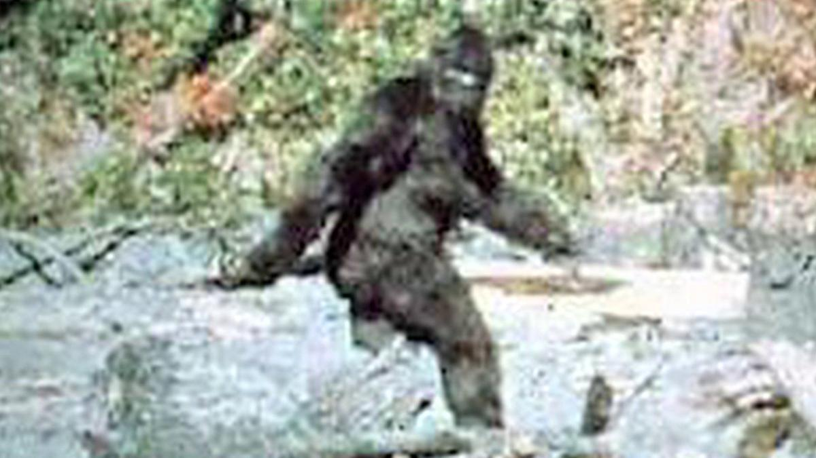
Sasquatch
Mysterious creature hides in the woods
Heard legends of it
Seeking more information, but don’t know where to start
After searching, convinced you’ve found a trail but still eluding you

Slide 3
SASQUATCH = "Short Attention Span Quantitative [stuff] yoU Admire That Can Help the rest of us"
However...

Slide 4
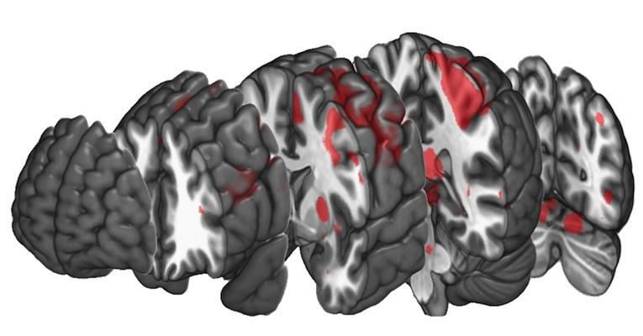
Sasquatch
MRIcroGL
Mysterious creature hides in the woods
Heard legends of it
Seeking more information, but don’t know where to start
After searching, convinced you’ve found a trail but still eluding you
Unknown application, hides in your favorite papers
Read methods about it
Seeking implementation suggestions, but can’t read through documentation
After searching, convinced you’ve found a trail but...still eluding you

Slide 5
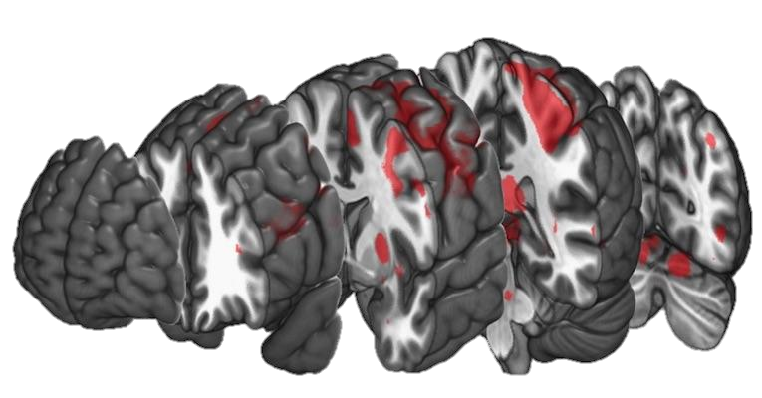
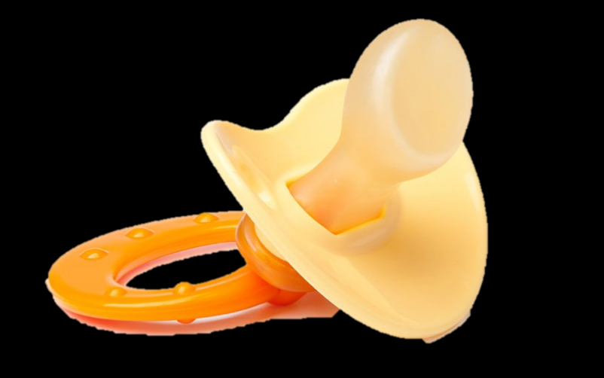

Slide 6

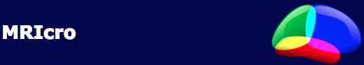
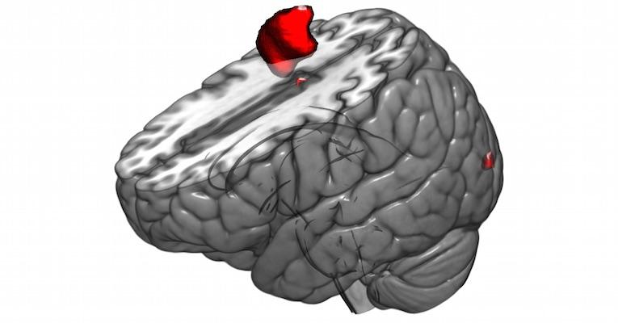
MRIcron
MRIcro
MRIcroGL

Slide 7
Contents
Intro
General Tools
Scripting
Neuroimaging examples
Do’s and Don'ts
Conclusions

Slide 8
Introduction
Real time interactive rendering for 3D medical imaging
Brain, Thorax, Beetles, and ...

Slide 9
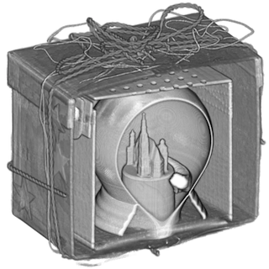
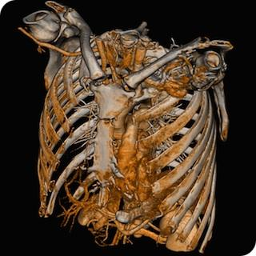
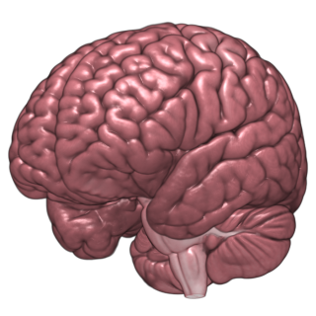
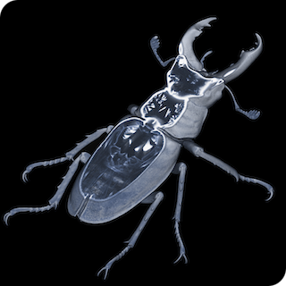
Introduction
Real time interactive rendering for 3D medical imaging
Brain, Thorax, Beetles, and Gifts
CRNL Website

Slide 10
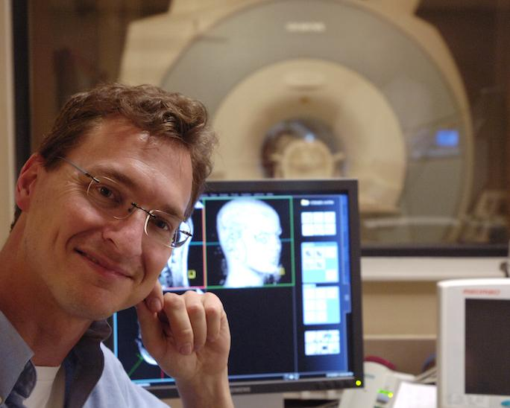


Introduction
Real time interactive rendering for 3D medical imaging
Brain, Thorax, Beetles, and Gifts
Runs on Windows, Linux, and OSX
Designed by Chris Rorden, scientist at USC
CRNL Website

Slide 11
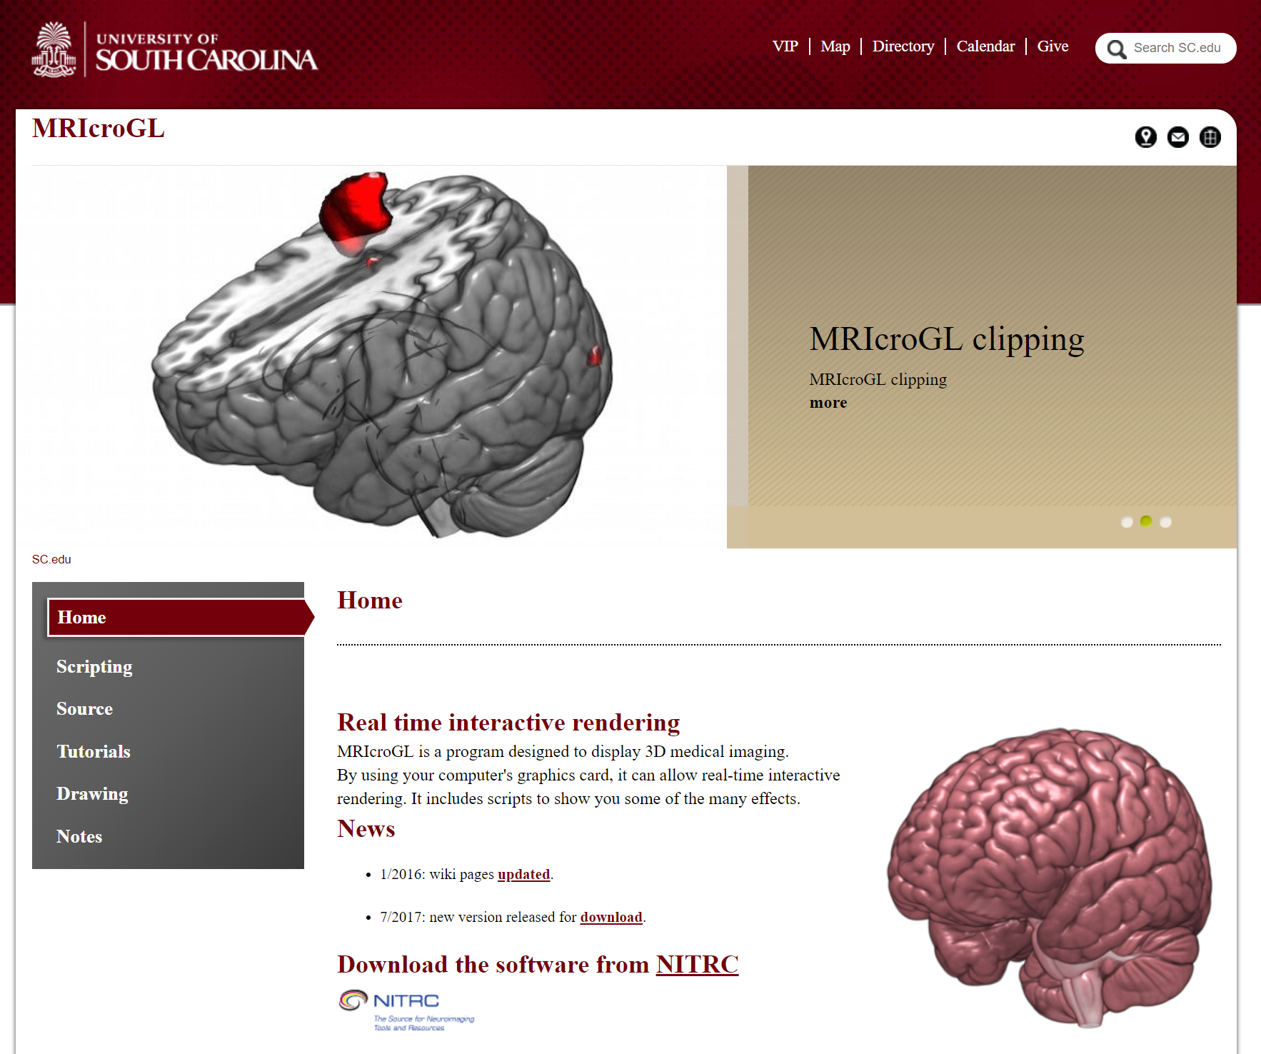
Introduction
Website: https://www.mccauslandcenter.sc.edu/mricrogl/home

Slide 12
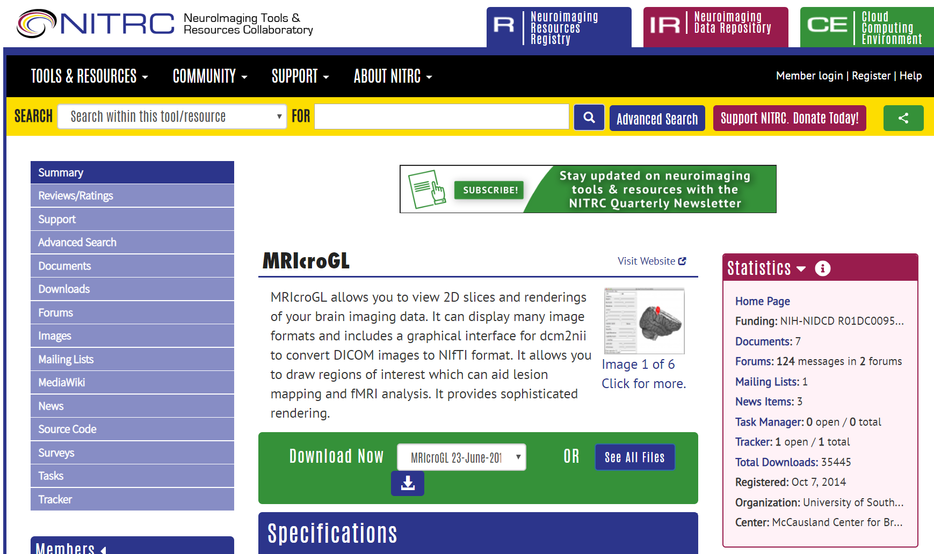
Introduction
Documentation: https://www.nitrc.org/plugins/mwiki/index.php/mricrogl:MainPage

Slide 13
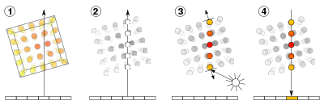
Introduction
Real time interactive rendering for 3D medical imaging
Further… MRIcroGL is an “open source volume ray caster”
Ray casting
Sampling
Shading
Compositing
Adaptive sampling reduces rendering time for high-quality renders
Multi-core CPU technology is perfect for this technique
Wikipedia
Notes:
http://www.rorydriscoll.com/2008/08/24/lighting-the-rendering-equation/
https://en.wikipedia.org/wiki/Volume_ray_casting

Slide 14
General Tools
Viewing images (NIFTI/Analyze, Bio-Rad Pic, NRRD, Philips, ITK, MetalImage, AFNI, Freesurfer, basic DICOM*)
dcm2nii function suggested for conversion*
Loading overlays (e.g. stat masks), with many editing tools
Rendered cutouts or clipping views, mosaics, and slices
Drawing regions of interest

Slide 15
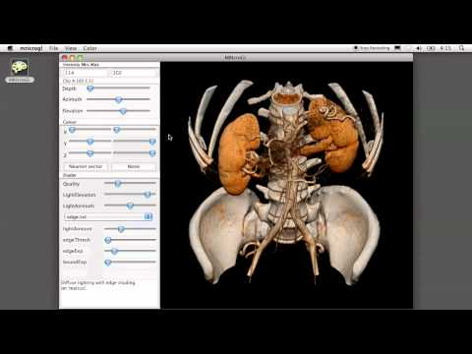
General Tools
Example of basic functionality of MRIcroGL
Chris Rorden YouTube

Slide 16
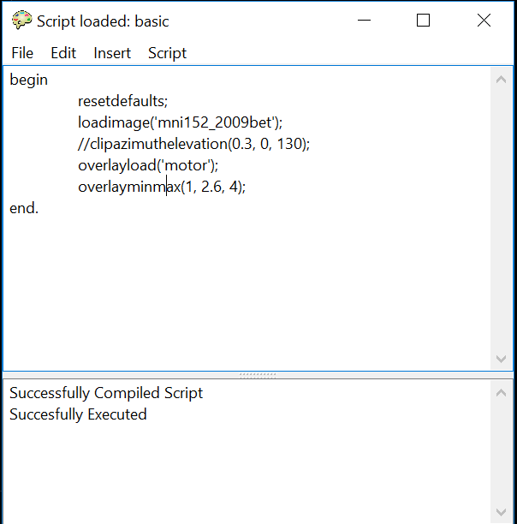
Scripting
Pascal and Python supported
Documentation primarily in Pascal
Tons of example script templates

Slide 17
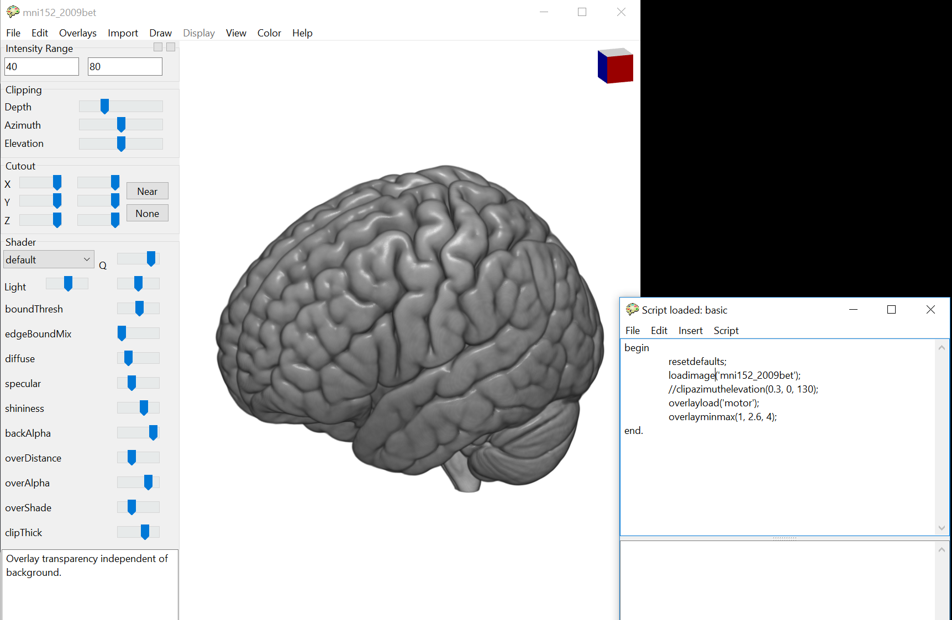
Scripting
Oathes Lab

Slide 18
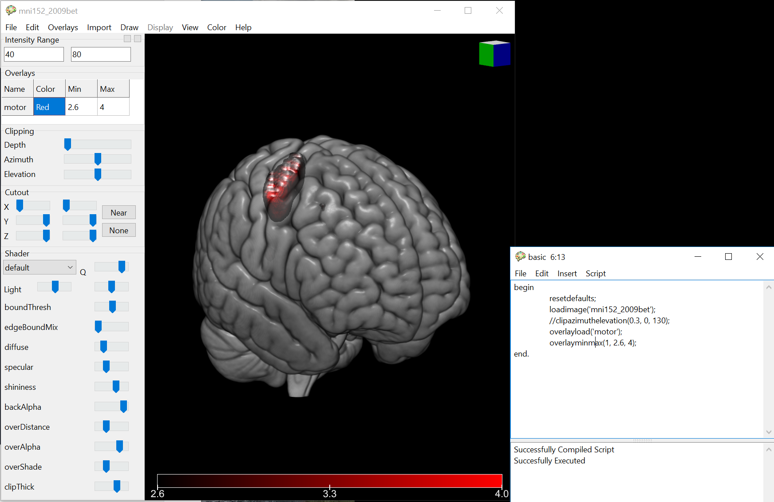
Scripting
Oathes Lab

Slide 19
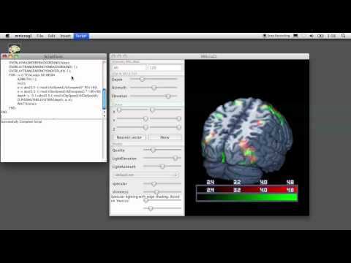
Scripting
Chris Rorden YouTube

Slide 20
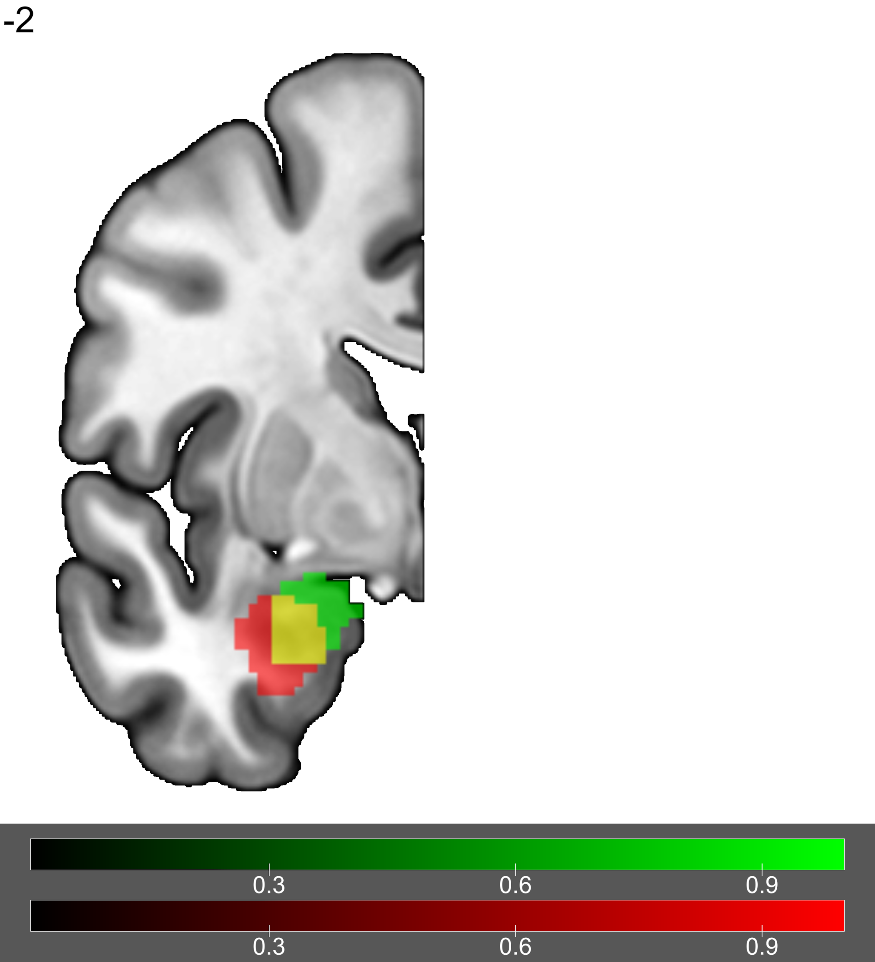
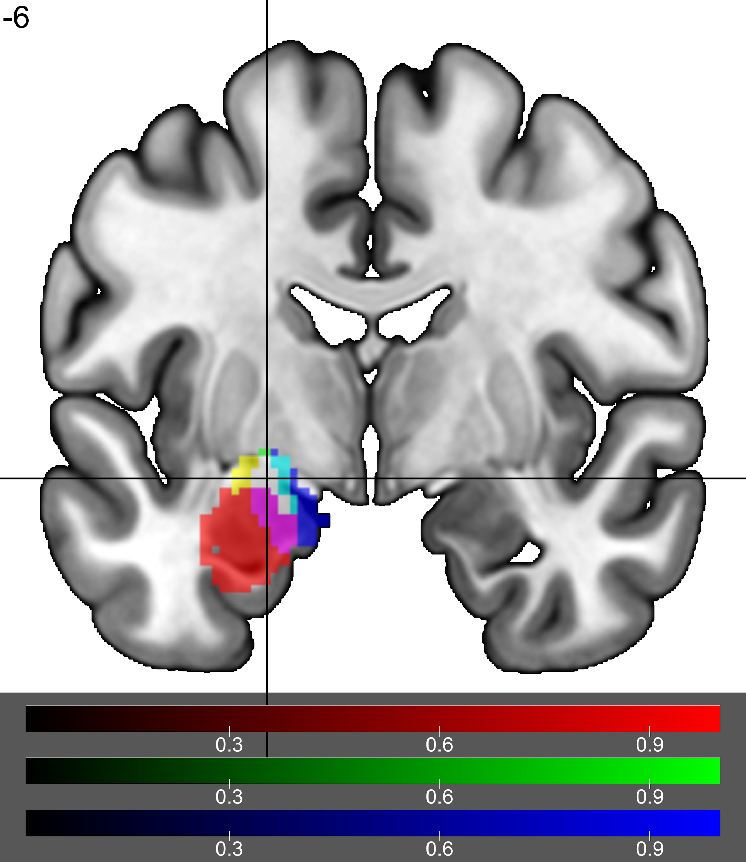
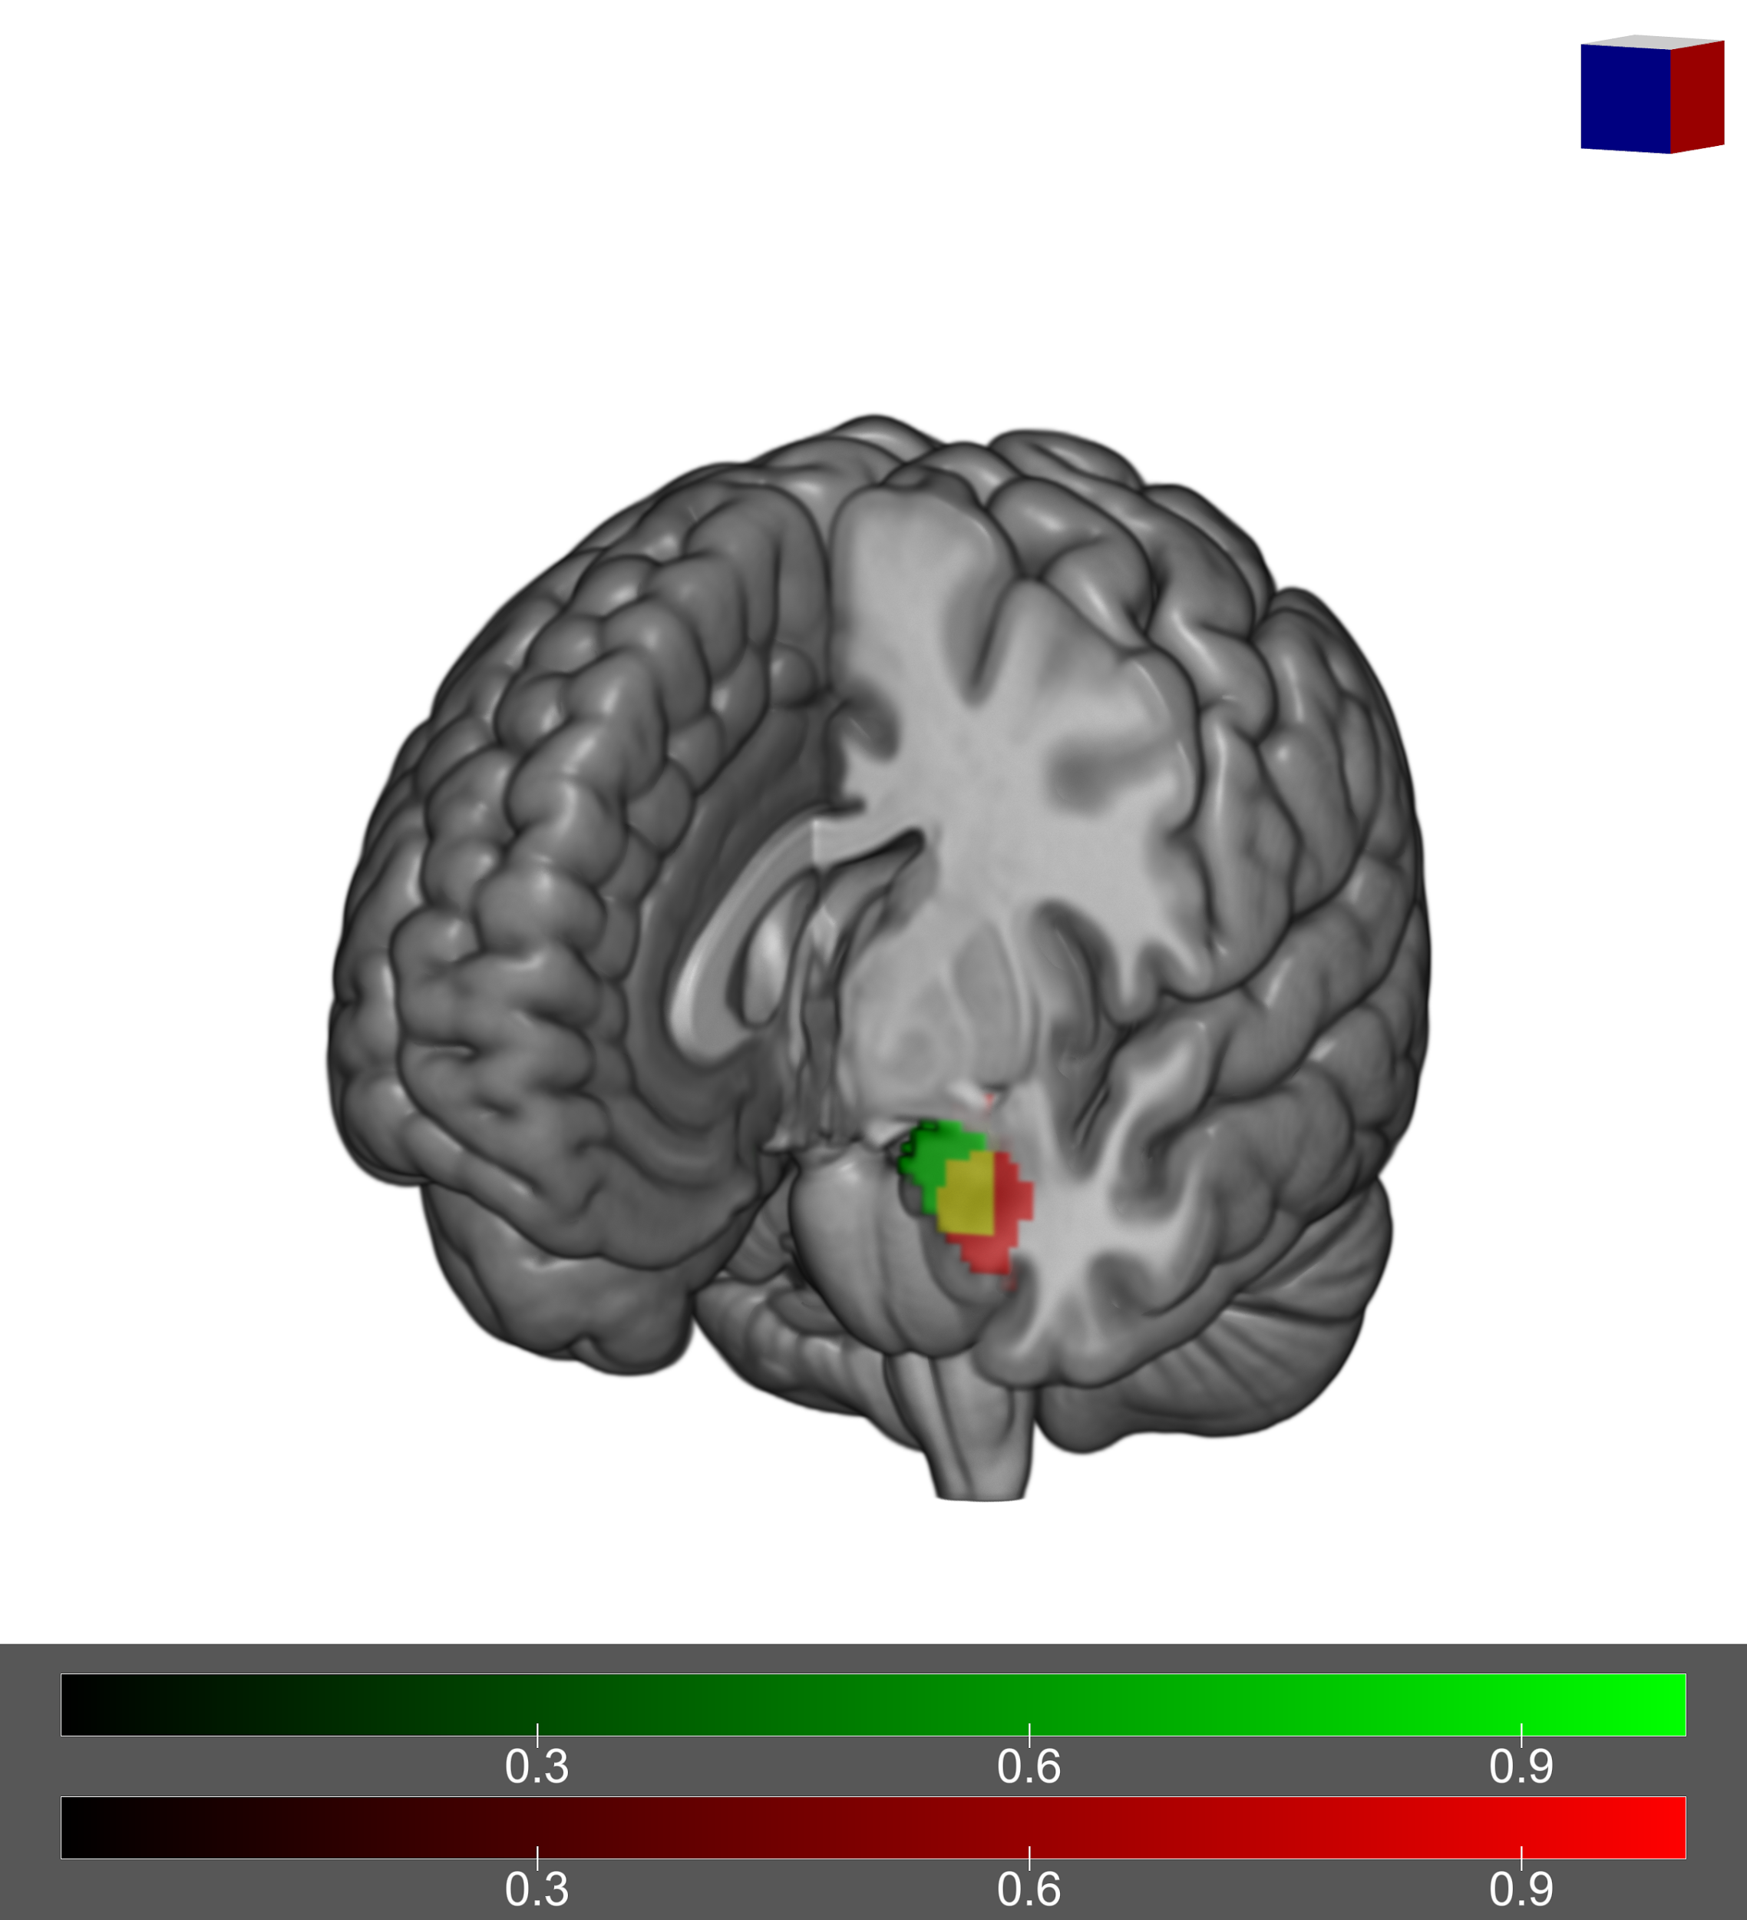
Neuroimaging Examples: Slice views
Oathes Lab

Slide 21
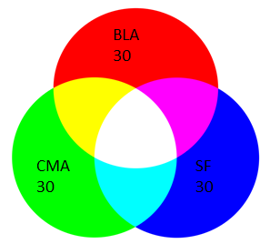
Neuroimaging Examples: Slice views
Oathes Lab

Slide 22
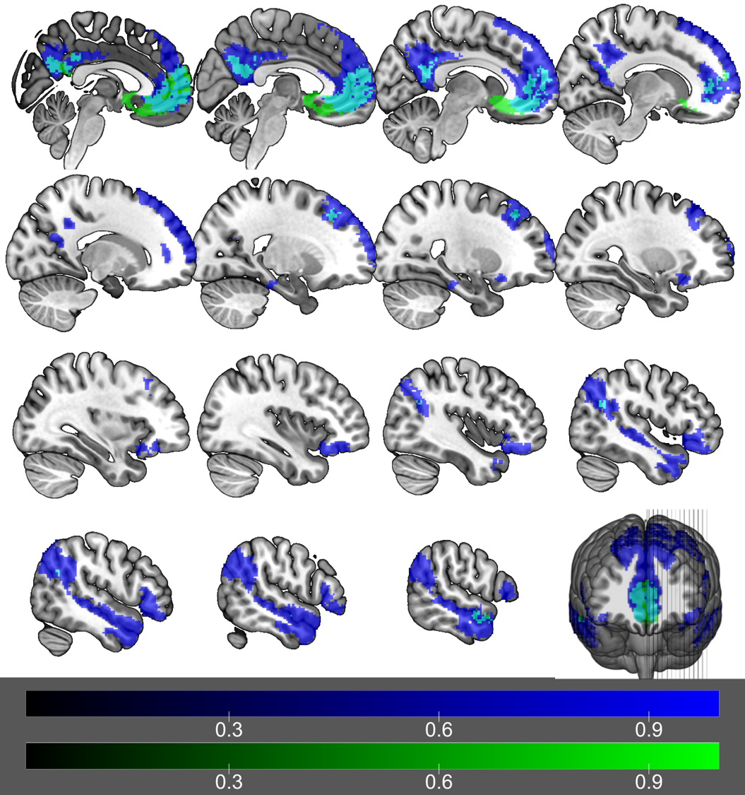
Neuroimaging Examples: Mosaic
Oathes Lab

Slide 23
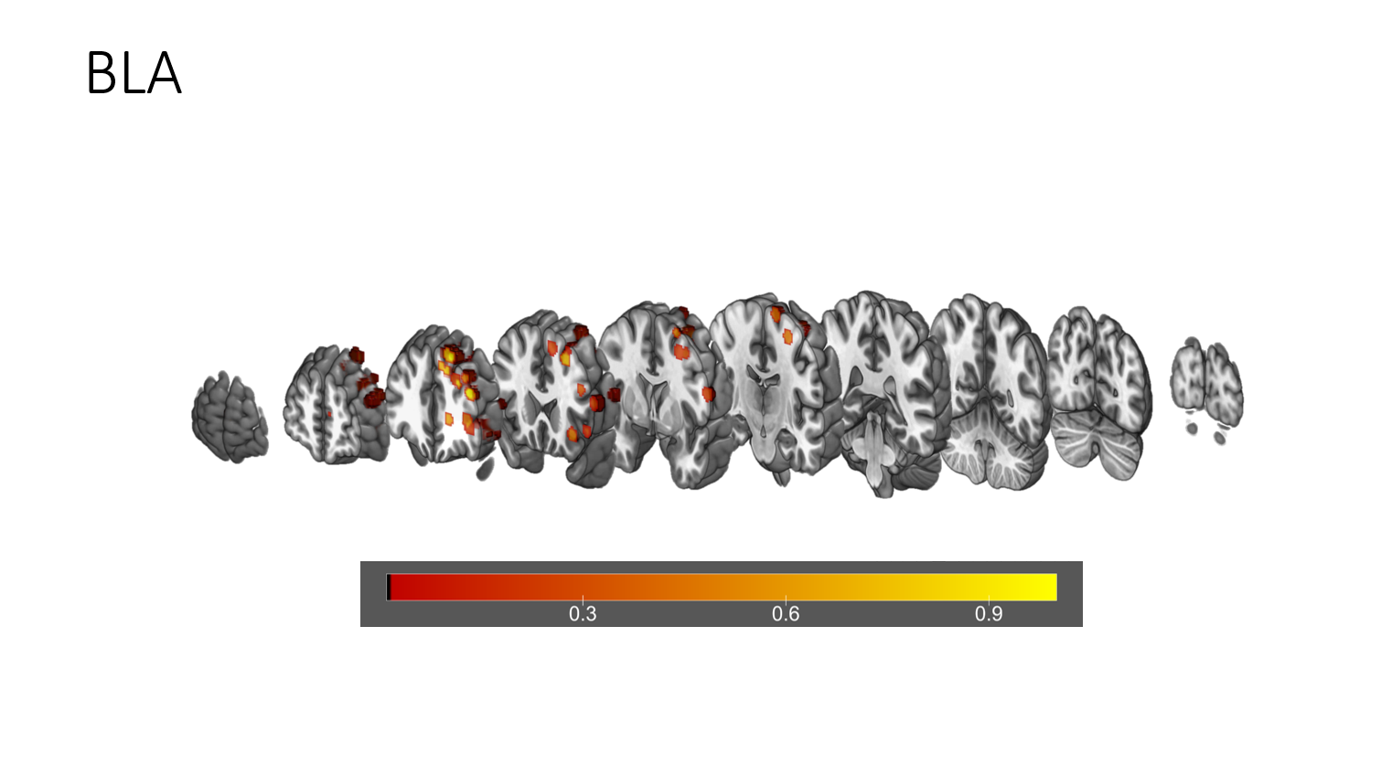
Neuroimaging Examples: “Exploded brain”
Oathes Lab

Slide 24
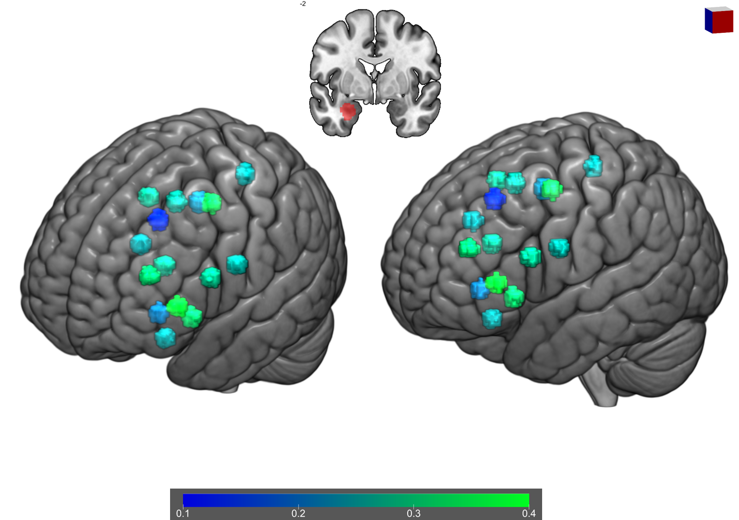
Neuroimaging Examples: Rendered
Oathes Lab

Slide 25
Do’s and Don’ts of MRIcroGL
DO:
Utilize scripting
Test your graphics card before making lots of edits
Read manual for context
DON’T:
Load binary masks using trilinear interpolation
Try to load >15 overlays onto a rendered brain
Use MRIcroGL to visualize everything

Slide 26
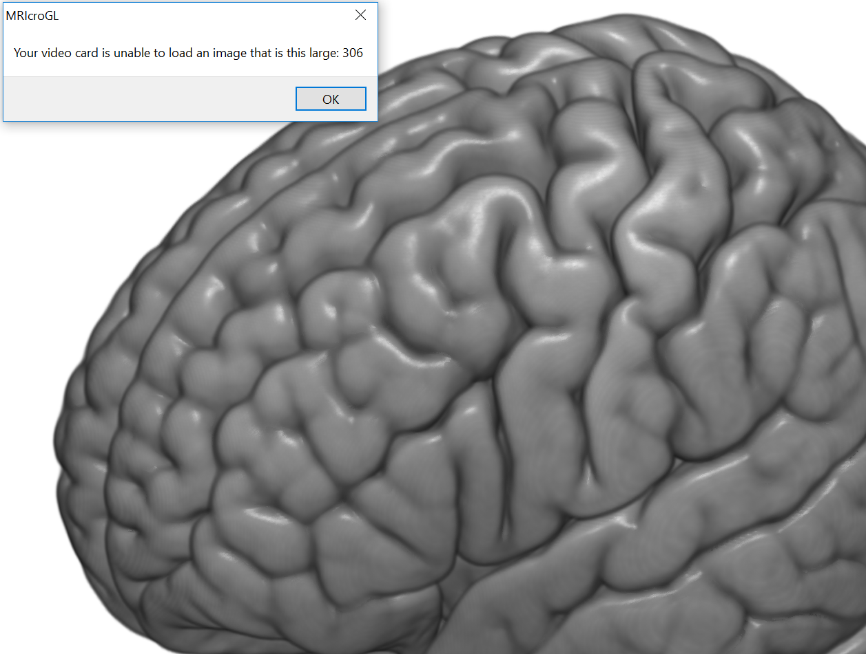
Do’s and Don’ts of MRIcroGL: Graphics

Slide 27
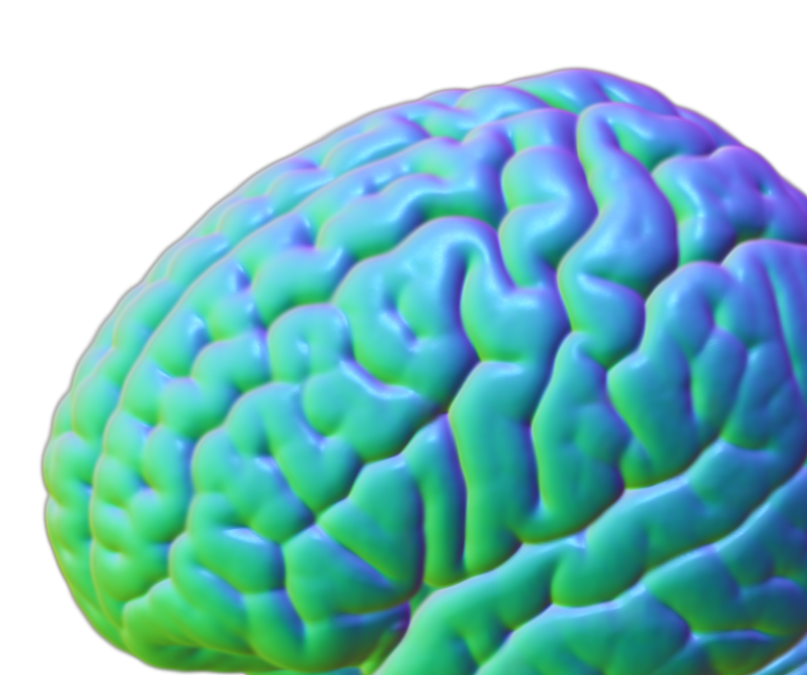
Do’s and Don’ts of MRIcroGL

Slide 28
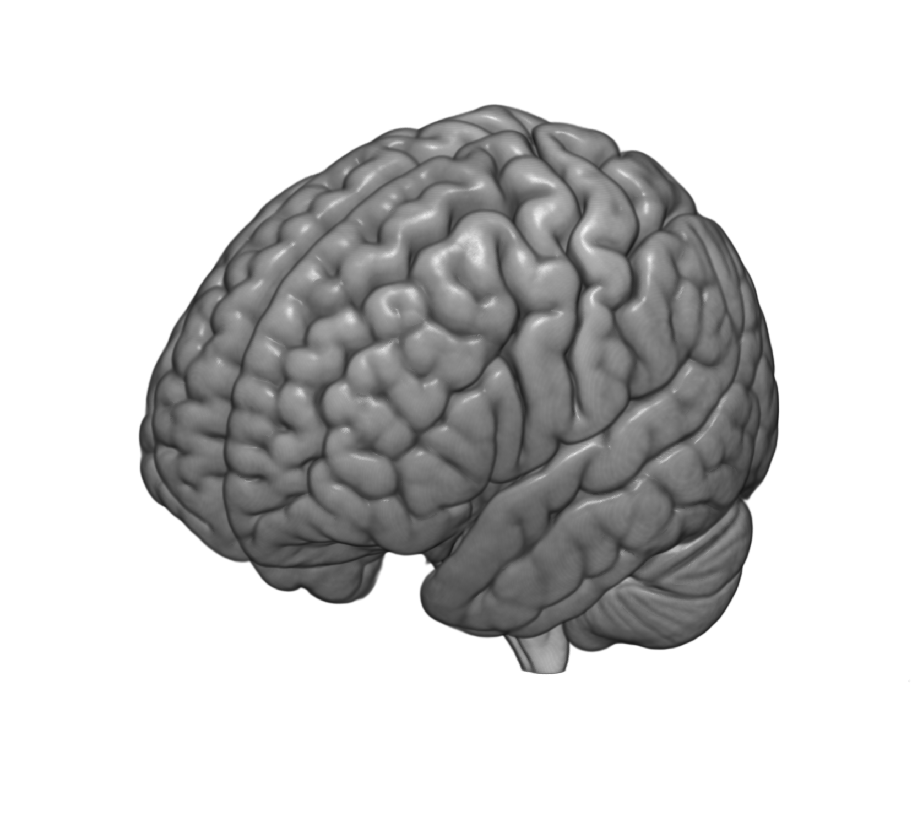
Do’s and Don’ts of MRIcroGL: Not for everything

Slide 29
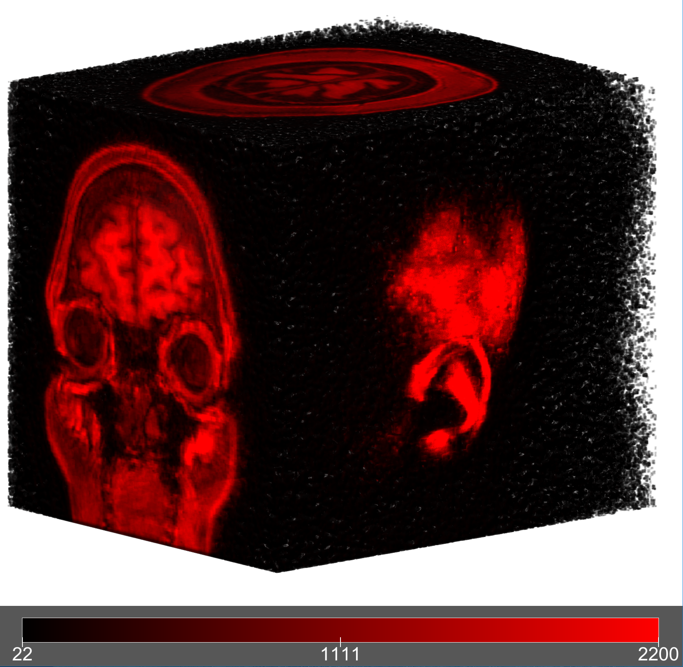
Do’s and Don’ts of MRIcroGL

Slide 30
Conclusions
Excellent high resolution medical image viewer
Scripting (Pascal, Python) allows quick, iterative figure creation
Supports ROI drawing* and DICOM→NIFTI conversion
*Consider ITK-SNAP for challenging drawings

Slide 31
Resources
Website: https://www.mccauslandcenter.sc.edu/mricrogl/home
Specifically, “Troubleshooting”: https://www.mccauslandcenter.sc.edu/mricrogl/troubleshooting
Download and Documentation: https://www.nitrc.org/projects/mricrogl/
Specifically, “MediaWiki”: https://www.nitrc.org/plugins/mwiki/index.php/mricrogl:MainPage
YouTube: https://www.youtube.com/user/pangeaist/videos?shelf_id=0&sort=dd&view=0

